Slide 1
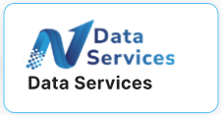

Fabric Not So Fabric

Slide 2
Data Architecture Principles
Source of Truth
Data Consistency & Integrity
  Data should be accurate, complete, and reliable across systems
  Use referential integrity, constraints, validation rules
Scalability
  Volume (more data)
  Velocity (faster ingestion)
  Variety (new data types: logs, unstructured, APIs)
Security & Privacy by Design
  RBAC
  DPDP / GDPR / CCPA / HIPPA compliances
Interoperability
Governance & Stewardship
Operational Excellence

Slide 3
Data Architecture Paradigm
Datawarehouse – Kimball Architecture
Information Reporting
Data Lake
Data marts
Data Lakehouse
Mesh
Fabric
Streaming
Semantic
Microservices

Slide 4
Data Fabric
Technology-driven architecture that provides a unified, intelligent, and automated way to connect, integrate, govern, and deliver data across an enterprise—regardless of where the data lives. Intelligent connective layer that sits on top of all your data systems
Integration & Orchestration
Automation & AI & Knowledge linked Graph Models
Centralized Data Store
Metadata Driven
Data Mesh
Data Mesh is a modern, decentralized data architecture designed to overcome the limitations of traditional centralized data lakes and warehouses
Decentralized ownership in Business Domain
Self Service through discovery
Federated & Governed – Metadata managed , Policy , Privacy
DATA as a PRODUCT

Slide 5
Microsoft Fabric
Unified tooling and services
Centralized storage – Onelake acts as a single data lake
Centralized governance & metadata
Single-platform, centralized data lake + governance + unified services = MS Fabric
Decentralized workspaces/domains
Treat datasets / semantic models / curated tables as “products” owned by domain teams (data engineers, analysts, domain owners), each with their own governance, lifecycle, and responsibilities
Federated governance model allows central policy enforcement
Domain centric, Data Pipeline , Shared Governance = MS Fabric

Slide 6
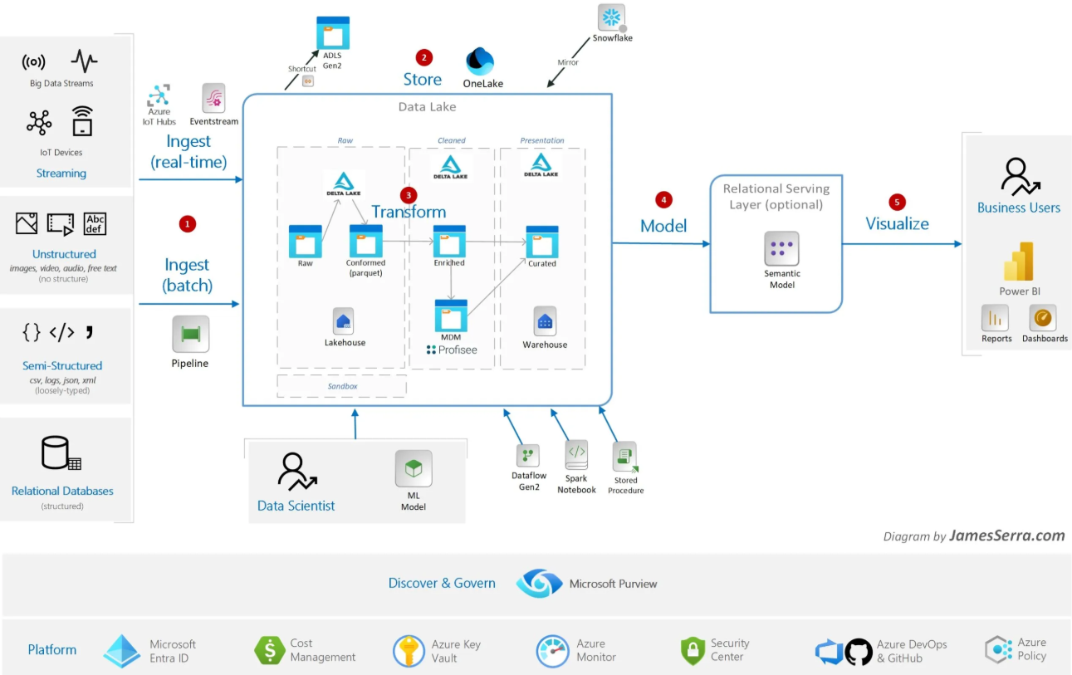
Microsoft Fabric - A unified data and analytics platform
Notes:
If Power BI is your JAM then FABRIC is your go to platform
Get data into Fabric - Data Engineering
Prepare Data – Data Transformation
Data Visualization
Data Security
Data Privacy

Slide 7
When should you opt for Fabric
You need a Lakehouse or Delta-based architecture
Single platform
Fast and native power bi capability
  Fabric allows Power BI to read Delta tables directly from the lake without import or refresh
You love Microsoft and don’t mind building the MS utility stack in organization
You want to reduce data copy
Low Code / No Code ETL development
Cloud stickiness is not a matter of concern
Want to move away from On-Prem services like SSIS/SSAS/SSRS
You don’t care about the underlying infrastructure complexities

Slide 8
Integration capabilities with Power BI & Power automate
Feature | Description
Native Workload | Power BI is hosted within the Fabric platform. This means that Fabric is the single environment where you perform data engineering, data warehousing, data science, and finally, data visualization with Power BI.
Direct Lake Mode | This is the most significant integration feature. Power BI reports can connect directly to the OneLake data (Delta tables in a Lakehouse or Warehouse) without importing, copying, or duplicating data. This delivers high performance and provides near real-time data for reports.
Unified Data | Power BI reports and semantic models consume data directly from the OneLake store, ensuring that analysts are always working with the exact same data copy as data engineers and data scientists.
Shared Security | Security and governance settings (like sensitivity labels and access control) established in Fabric are automatically enforced when the data is consumed by Power BI.
Feature | Description
Workflow Orchestration | You can use Power Automate to trigger Fabric data pipelines, dataflows, and notebooks based on external events
Data-Driven Actions | The Data Activator feature in Fabric allows you to set up conditions and thresholds on your data. Data Activator can automatically trigger a Power Automate flow to take immediate action

Slide 9
Data management capabilities
Unified Data Storage (OneLake)
Data Integration and Ingestion
Mirroring
Data Factory (ETL/ELT)
Eventstreams
Security and Governance
Integration with Microsoft Purview
Universal Security
Centralized Administration
Data Lineage
Sensitivity Labels
Data Quality and Maintenance
Data Retention Policies: Controls mechanisms to automatically remove data from tables or materialized views based on defined timeframes
Caching Policies: Allows control over which data should be cached to optimize performance for queries
Monitoring Hub: Provides a single pane of glass to view and troubleshoot all pipelines, data refreshes, and other jobs

Slide 10
Top use cases across domains
Data Mesh architecture for managing your supplier information and building a master catalog of its inventory
Real time streaming of sensor data into one lake for anomaly detection
Built in AI/ML for predictive maintenance, optimization, forecasting
Copilot integration
A unified financial data model (loans, deposits, cards)
Fraud detection
Unified data platform for data aggregation and consolidation for various source systems like ERP / CRM / Student Management / Course Management / Student Outcomes

